Slide 1
History of Web Development
Multi-page Websites, Templating Engines, Single-page Applications

Slide 2
How’d we get here?

Slide 3
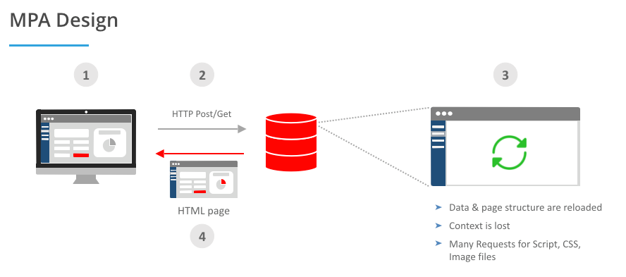
Multipage Web Applications (MPA)
Every page is its own html file
Each request to the server reloads the entire page and potential renders a different page
Can be slow because all images and CSS must be re-rendered on reload

Slide 4
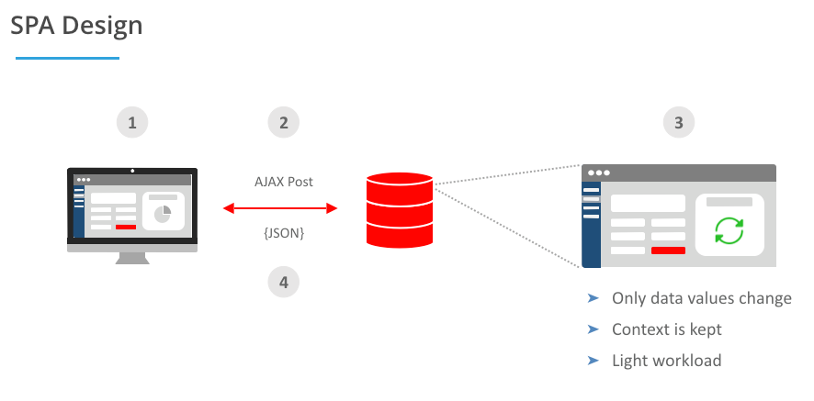
Single Page Applications
Slow initial loading times, but page updates are significantly faster
Much better for interactive web sites / web applications
Initial request loads the 1 html file and all JS, then subsequent requests just receive JSON data

Slide 5
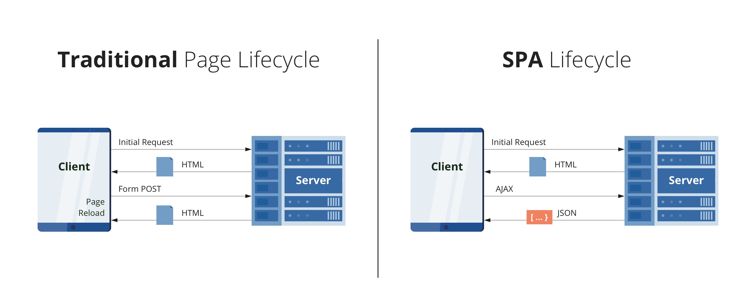
Recap

